Slide 1
PERFORMANCE COMPARISON OF PRIM’S ALGORITHM USING DIFFERENT PRIORITY QUEUES
By:
Anusha J (ENG18CS0041)
Anusha R (ENG18CS0043)
Arun Kumar (ENG18CS0047)
Bhavana G (ENG18CS0059)

Slide 2
Overview
Prim’s algorithm using
1. Adjacency Matrix – Lazy & Eager Naive Approaches
2. Adjacency Lists – Binary Heap
3. Adjacency Lists – Fibonacci Heap

Slide 3
Prim’s Algorithm
Algorithm to find minimum spanning tree.
Select minimum weight edges keeping the selection connected at every step. Avoid cycles.
Other MST algorithms are:
1. Kruskal’s Algorithm
2. Reverse-Delete Algorithm
3. Boruvka’s Algorithm

Slide 4
Adjacency Matrix – Lazy & Eager Naive Approaches
Eager Approach - Add vertices to the priority queue.
Lazy Approach is more intuitive but slow. Add edges of the source vertex to the priority queue initially and use extract minimum and insert operations thereafter.
We use an adjacency matrix for both of these so the time complexity is O(|V|²)

Slide 5
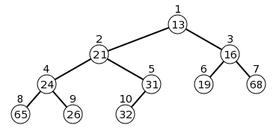
Adjacency Lists – Binary Heap
Complete binary tree.
A node is greater than or equal to parent.
Implementation is array based.
ExtractMin & DecreaseKey are the main operations.

Slide 6
Adjacency Lists – Fibonacci Heap
List of heap ordered trees.
Each heap ordered tree is a minheap.
ExtractMin & DecreaseKey are the main operations.

Slide 7
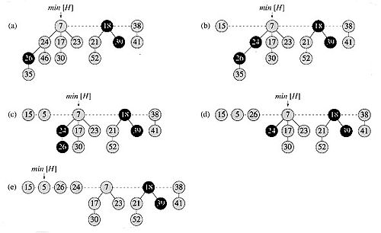
Adjacency Lists – Fibonacci Heap

Slide 8
What’s Changed Since the Last Project Review?
Corrected performance comparison plots.
Ran the tests again and generated more accurate plots.
Improved UI.
Confirmed that the algorithm works with negative edges.
Executed the implementations with a 10000 vertex complete graph, but ran out of memory.

Slide 9
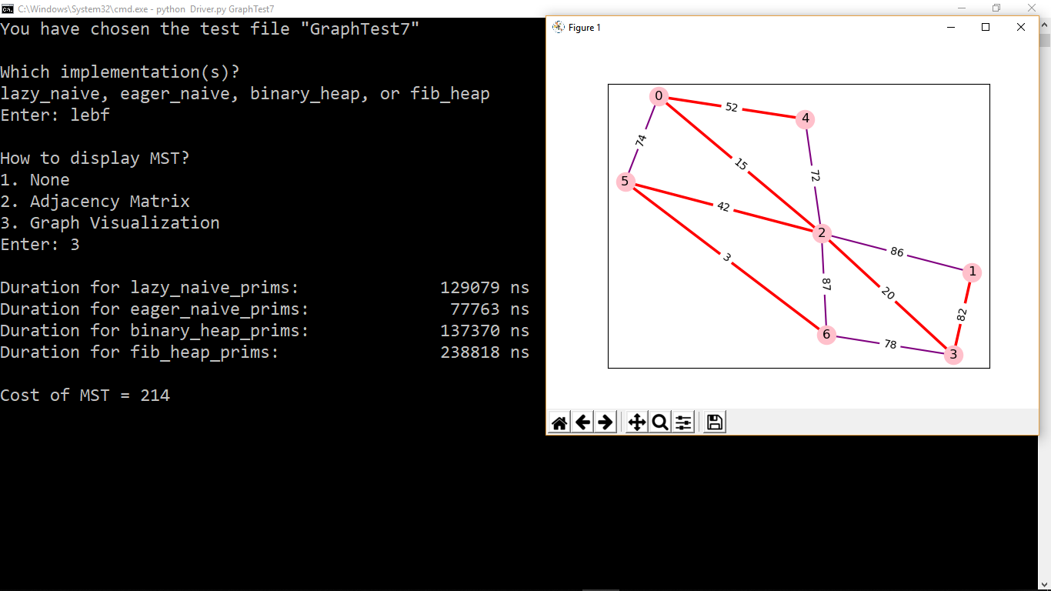
Screenshot

Slide 10
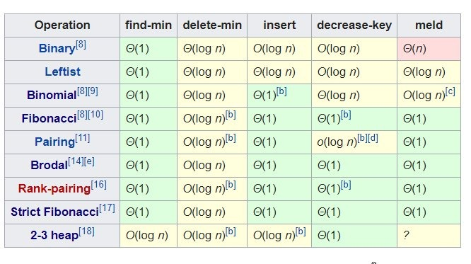
Time Complexity Comparison
[b] – Amortized time

Slide 11
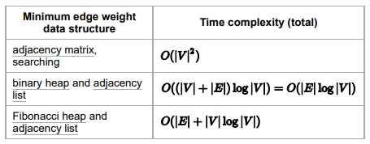
Time Complexity Comparison

Slide 12
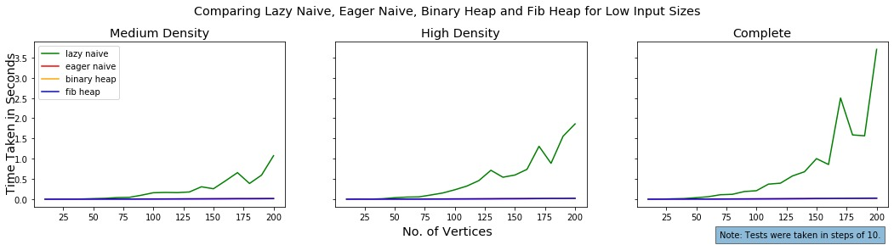
Performance Comparison
Lazy naive approach is the slowest.

Slide 13
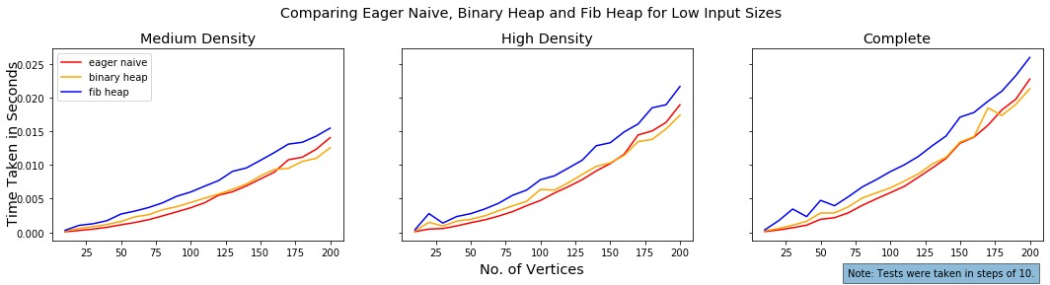
Performance Comparison
When we ignore lazy naive, fib heap is the slowest for low input sizes.

Slide 14
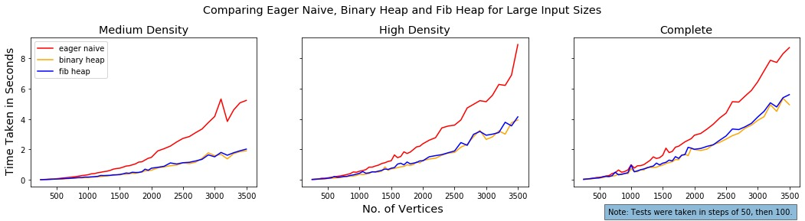
Performance Comparison
For large input sizes (>250), eager naive approach is the slowest.

Slide 15
Thank you for reading.

